Slide 1

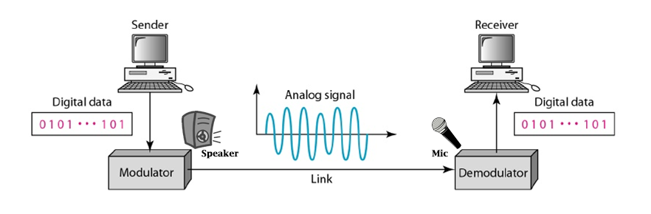
Data Leakage from Air-Gapped Systems over Ultrasonic Waves
Professional developer
Saad iqbal
principal investigator
Dr. syed ali hassan

Slide 2
General Description
How project was conceived?
***************************************************************************
No significant literature regarding implementation of such system is available.
This project includes the design & development of Covert Acoustic Transmission system in short period of 4 months.
Both Platform dependent code and Platform independent code are written for such system.
Notes:
The goal of developing such system is to analyze the threats and vulnerabilities that lie in the hardware and software part of the audio system which will eventually be used to increase the security of sensitive digital information and data located in the computers.

Slide 3
System Specifications
Reliability & higher Data rate
Covert
comm.
Silent features
Far distance
System Requirements are:
Covert acoustic communication (Hard to listen/detect)
Communication at higher distance up to 3 to 5m
Accurate & reliable data transmission at higher possible data rate

Slide 4



Milestones & Objectives
Objective # 1:
Uni-directional data transmission through covert acoustic channel between two distant PCs/Laptops
One PC is acting as transmitter using its speakers and other is acting as receiver using its microphones
Objective # 3:
Bi-directional data transmission through covert acoustic channel between two distant PCs/Laptops using only connected passive speaker
Other properties are similar to the previous model.
Objective # 2:
Bi-directional data transmission through covert acoustic channel between two distant PCs/Laptops
Both PC can transmit and receive data.
The concept of virtual “tokens” is used, token is required to transmit data.
Transmitter
Transceiver Client
Transceiver Client
Receiver
Transceiver Server
Transceiver Server
Uni-directional Transmission Protocol
Bi-directional Transmission Protocol
(Using only Passive speakers)
Bi-directional Transmission Protocol

Slide 5
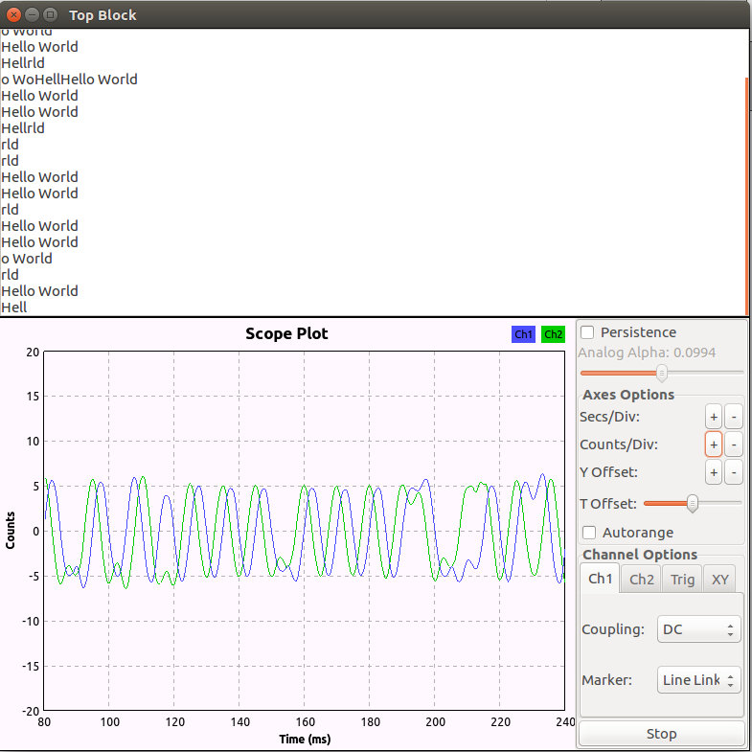
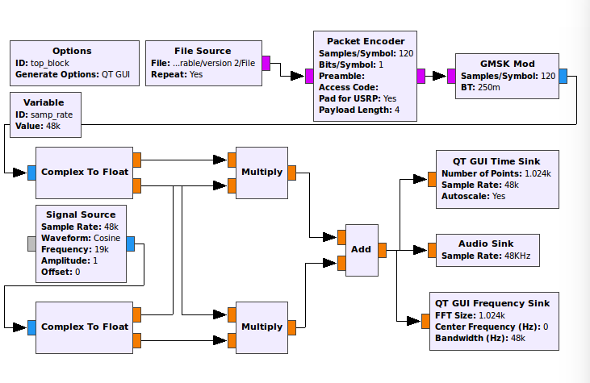
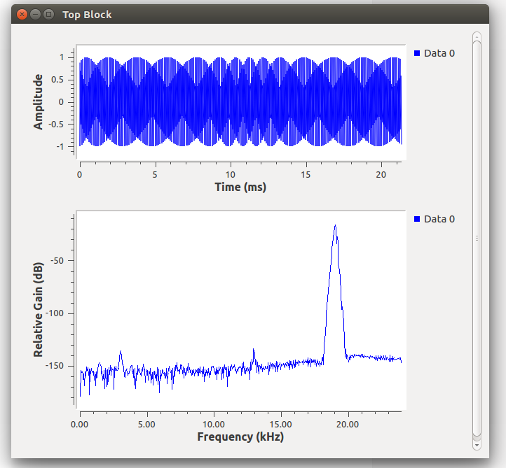
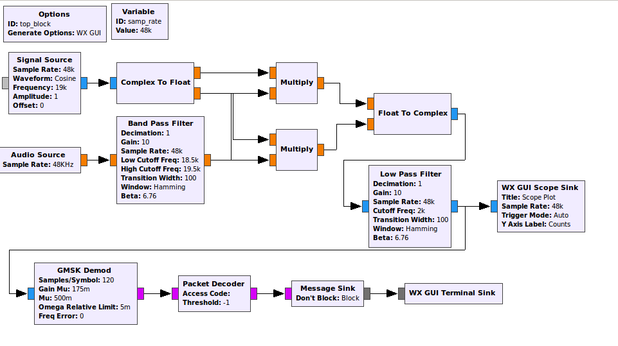
Methodology
Features of acoustic transmitter:
Developed in open-source platform GNU Radio.
Gaussian Minimum Shift key (GMSK) modulation is used.
Sampling frequency is 48 KHz and center frequency is 19 KHz.
Features of acoustic receiver:
Developed in open-source platform GNU Radio.
Gaussian Minimum Shift key (GMSK) demodulation is used.
Sampling frequency is 48 KHz and center frequency is 19 KHz.
Receiving message of ‘Hello World’ acting as proof of concept (POC) for Acoustic data communication
Phase # 1:
The concept of “Covert data transmission through Acoustic system” tested through designing its basic model in GNU-Radio
Model of Acoustic Transmitter in GNU Radio
Model of Acoustic receiver in GNU Radio

Slide 6
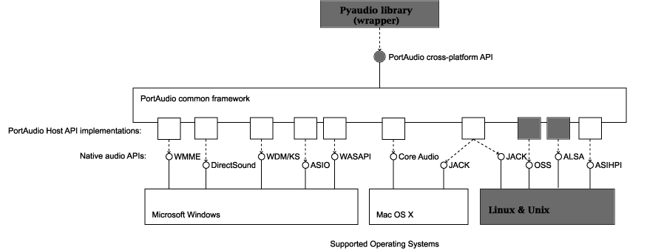
Methodology
Selecting optimal modulation and demodulation scheme:
Selected CPFSK with modulation index m = 2.
Covert acoustic friendly and no memory element needed.
f₀ = 18.8 KHz & f₁ = 19.2 KHz.
As, f_{s} = 48 kHz and ∆f = 400. Therefore, bit-rate = 200 bits/sec.
Coherent zero crossing detector (ZCD) based demodulation scheme is used.
Selecting optimal sound API for directing PC audio system:
Used Pyaudio library (wrapper) of Portaudio API to access the lower level functionality of sound system of PC/Laptop.
Coding is done in Python scripting language.
No advance library is used in writing program
Every module is written from scratch
Over 1000+ lines of code
Phase # 2:
Developing optimized and acoustic friendly modulation & de-modulation scheme for data transmission
Selecting most promising and potential sound API for directing & communicating with microphones and speakers of the system
Modulation & De-modulation schemes
PSK
FSK
BPSK
QPSK
CPFSK
Non-CPFSK
MSK
CPFSK + memory less
GMSK

Slide 7
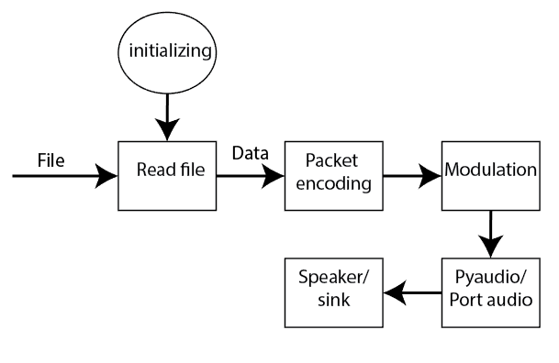
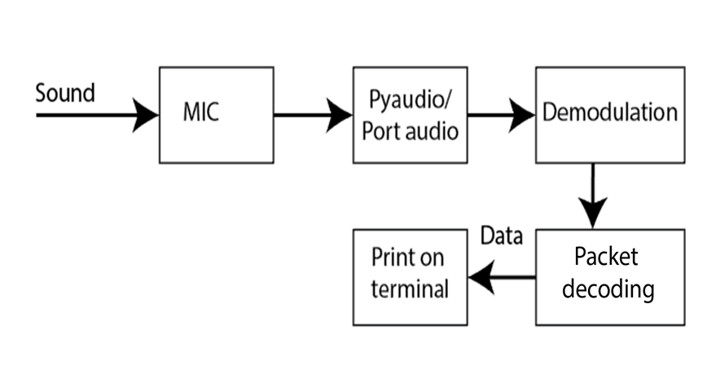
Methodology
Transmitter
Packet encoding Scheme
Phase # 3:
Designing of Uni-directional covert acoustic comm. system between two PCs
Preamble
Pkt count(optional) + Payload
CRC
10101010
8 bits
48 bits
8 bits
Receiver

Slide 8
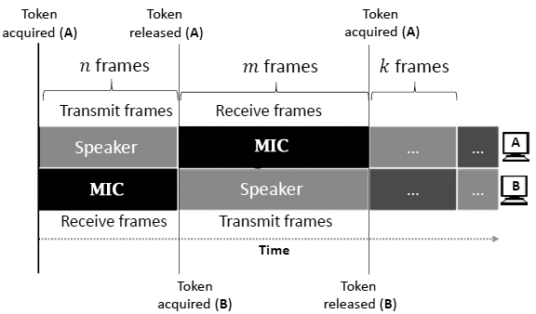
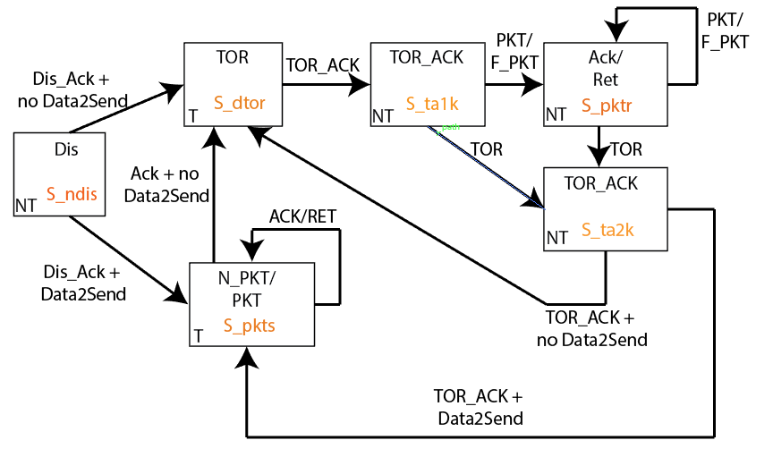
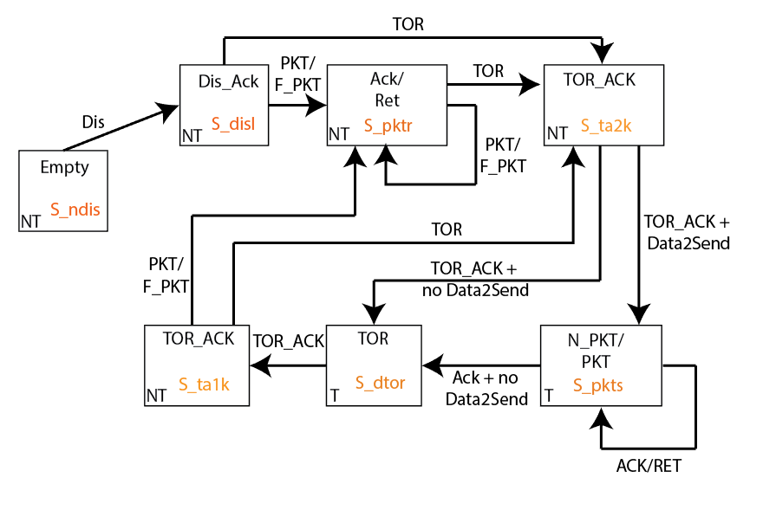
Methodology
Bi-directional covert acoustic communication system:
Consist of two parts:
Client
Server (Broadcast it’s presence)
Phase # 4:
Designing of Bi-directional covert acoustic comm. system between two PCs
Server side Flow graph
Client side Flow graph
Communication Protocol of Bi-directional acoustic Communication System

Slide 9
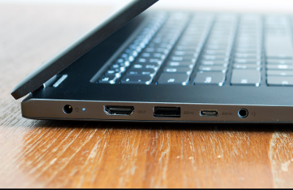
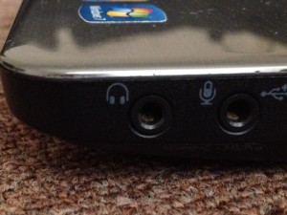
Methodology
Passive Speaker/audio based system
Audio system which doesn't have any active amplifier circuit.
System based on passive speakers works ☺ but they have short comes ☹:
There is no amplifier next to jack, therefore range reduce to less than 1m.
Data-rate reduces to ~10 bits/sec.
Passive speaker impedance matching also plays critical role.
Uni-directional acoustic system with receiver as passive speaker would be the best case scenario.
Phase # 5:
Designing of covert acoustic comm. system by using only passive speakers
Laptop with Combo/TRRS Jack
Laptop with multiple TRS Jacks
The passive speaker connected to combo jack can be converted into MIC by just port retasking command.
The passive speaker connected to audio out TRS jack can be converted into MIC by Jack retasking command.

Slide 10
Future Work/ demo
Design & Develop application to detect covert acoustic transmission
Mobile application of covert acoustic communication model
Create mesh network of covert acoustic communication system
Enhance the features & specifications of this system/model
DEMO
Part A:
File transfer from one system to another using covert acoustic transmission protocol
Part B:
Bi-directional data transferring between two systems using covert acoustic transmission protocol

Slide 11
Thank You

Slide 12
Timeline of the Project
Literature Review
6/1/2018 - 6/16/2018
Setup the required H&S
6/17/2018 - 6/27/2018
DEMO 1 & 2
9/21/2018 - 9/31/2018
Two computers, bidirectional acoustic communication over few meters
8/31/2018
Two computers, bidirectional acoustic communication over few meters by using passive speakers only
Single computer, One-way acoustic communication
7/10/2018
9/20/2018
Two computers, One-way acoustic communication over few meters
Kick Off
Sign Off
6/1/2018
7/30/2018
9/31/2018
May
Jun
Jul
Aug
2018

Slide 13
Total Cost
Sr. No. | Description | Amount
1 | Remuneration to PI @
2 | 1 X Professional Developer @
3 | Project Equipment
4 | Audit/Accounts
5 | Secretariat/Project Coordination Staff
SUB-TOTAL:
6 | 10% University overheads (functional ORIC)
7 | Miscellaneous
Grand Total:

Slide 14
Cost Breakup
Plant Machinery & Equipment: | PKR 169,000.
Human Resource / Salaries:
Admin / Miscellaneous
TOT / Consultancy
Lab / Building & Civil Works
Operational Cost:
Training:
Vehicle / Office Equipment:
Recurring Cost:
Financial Phasing | Required in advance at the start of the project as lump sum
Grand Total Cost:

Slide 15
Logical Reasoning
Clicking Noise Removal:
Hardware limitations.
Can suppress by gradually increasing and decreasing the sound while transmission.
Bi-directional Passive Covert Acoustic System:
Need impedance matching circuit between the speakers and laptop headphone Jack ~32Ω.
Frequency & Clock synchronization:
Need developing of dedicated receiver/demodulation technique equipped with Mueller and Muller algorithm for clock synchronization.
FSK to MSK:
Shifting to MSK can be used to enhance the capacity of channel while being in covert mode.
Bi-directional Protocol Flow graph improvement:
Removing the acknowledge part in the flow graph.

